Slide 1

Presentation of Ongoing Research Activities November 2014
Mokter Hossain
Doctoral Candidate
Department of Computer Science
The University of Alabama

Slide 2
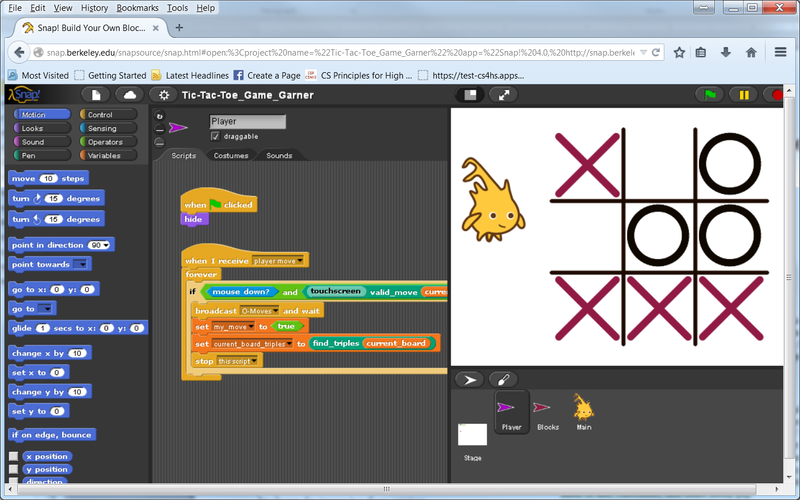
1. An Investigation of the Usefulness of Snap's User Interface

Slide 3
1. An Investigation of the Usefulness of Snap's User Interface
Purpose, Objectives, Design:
The purpose of this study is to evaluate the usefulness of the Snap Programming Language’s User Interface, the programming environment.

Slide 4
1. An Investigation of the Usefulness of Snap's User Interface
Study Procedure:
We have developed an online Survey Instrument with Google Docs.
The survey is available online at:
http://goo.gl/forms/NZYWwXS1hf

Slide 5
1. An Investigation of the Usefulness of Snap's User Interface
Subject Recruitment Method:
Email Solicitation to the Participants
Summer Workshops; and
Students of the these participants who will be programming with Snap, during the Fall 2014, Spring 2015, and Fall 2015 semesters.
Expecting 50 – 500 participants

Slide 6
1. An Investigation of the Usefulness of Snap's User Interface
Subject Recruitment Method:
Email Solicitation to the Participants
Read Aloud text

Slide 7
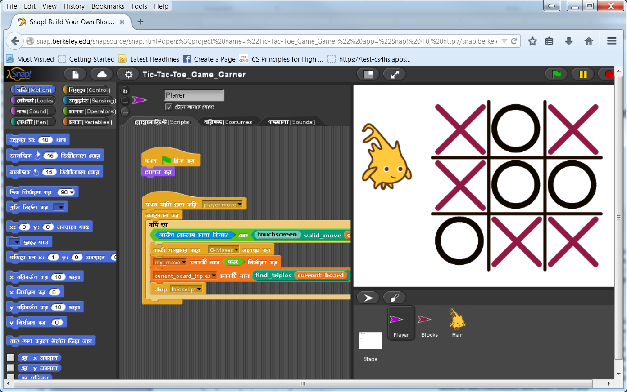
2. SnapBangla- Translating and Promoting Snap! Programming in Bangla

Slide 8
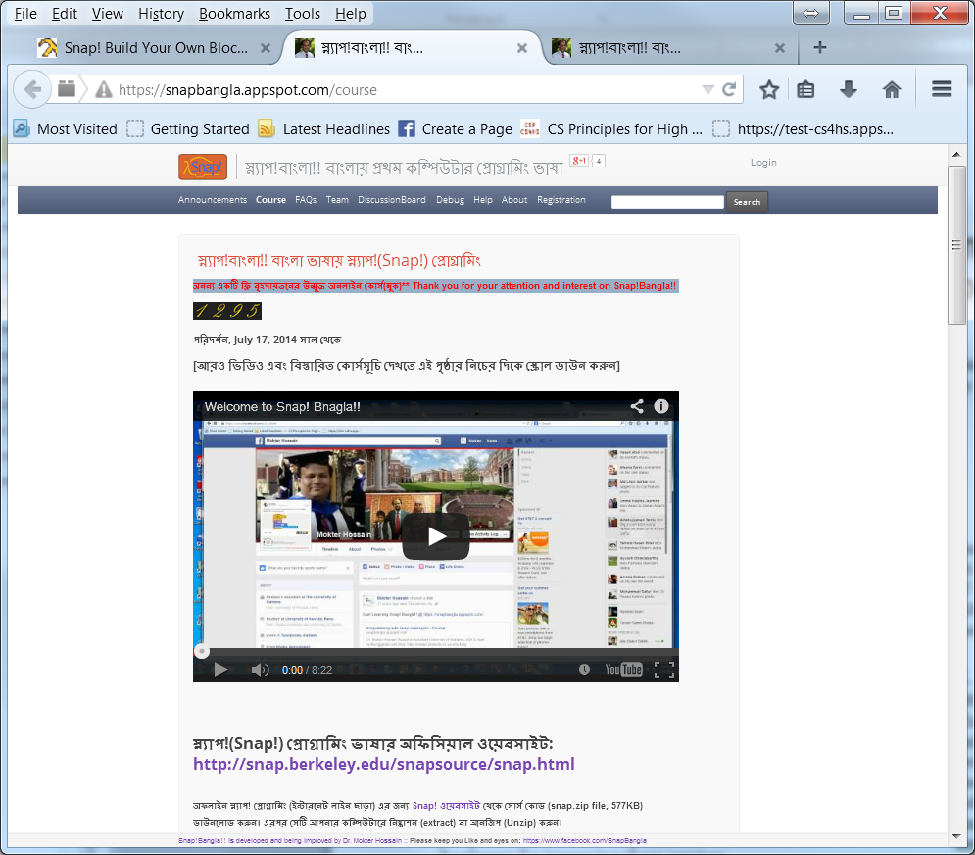
2. SnapBangla- Translating and Promoting Snap! Programming in Bangla

Slide 9
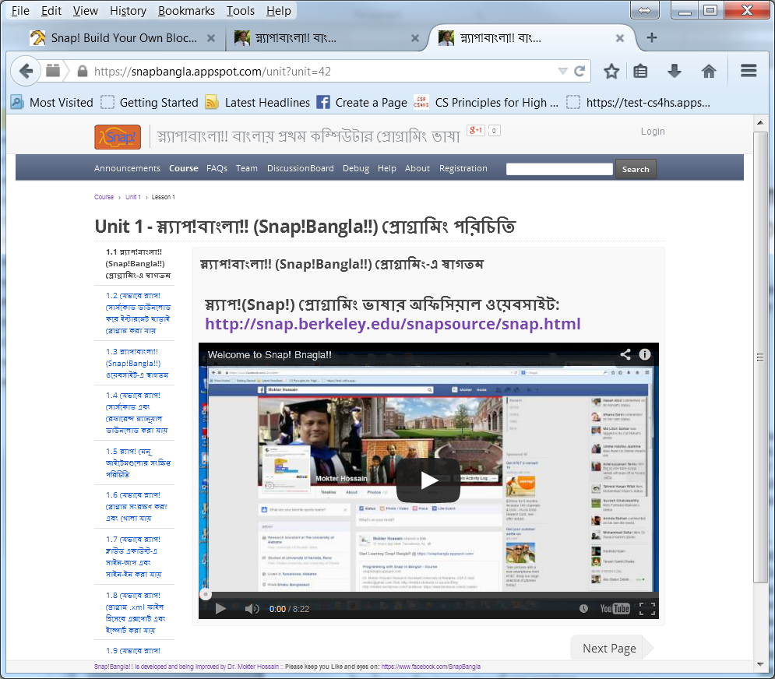
2. SnapBangla- Translating and Promoting Snap! Programming in Bangla

Slide 10
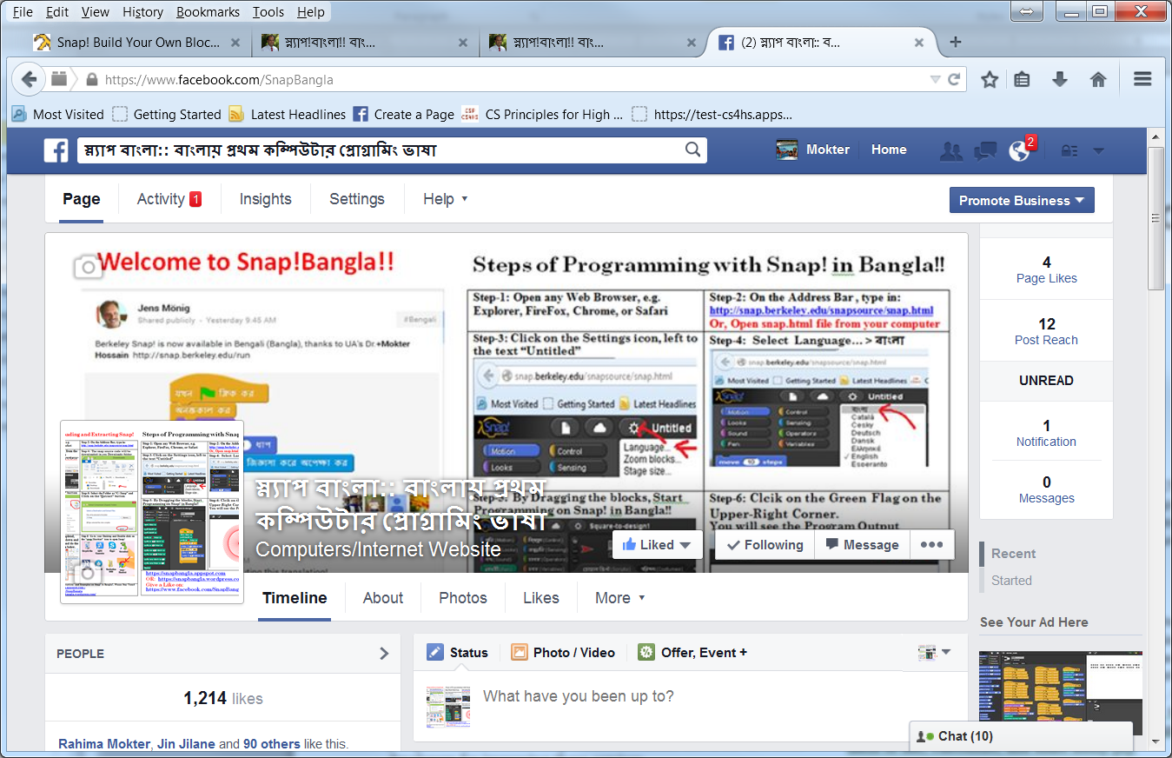
2. SnapBangla- Translating and Promoting Snap! Programming in Bangla

